Slide 1
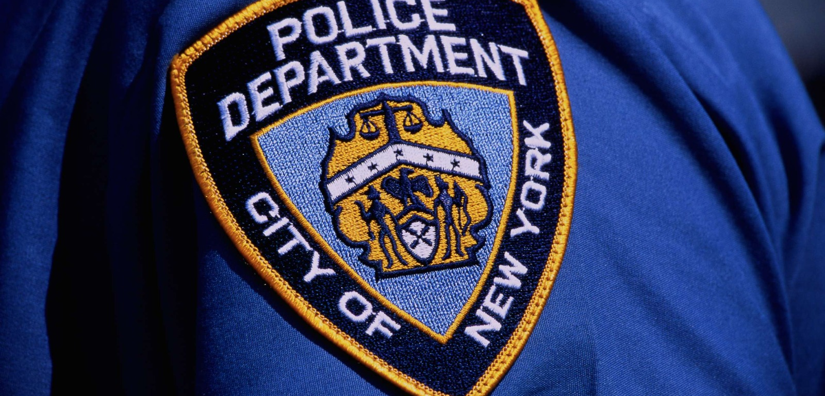
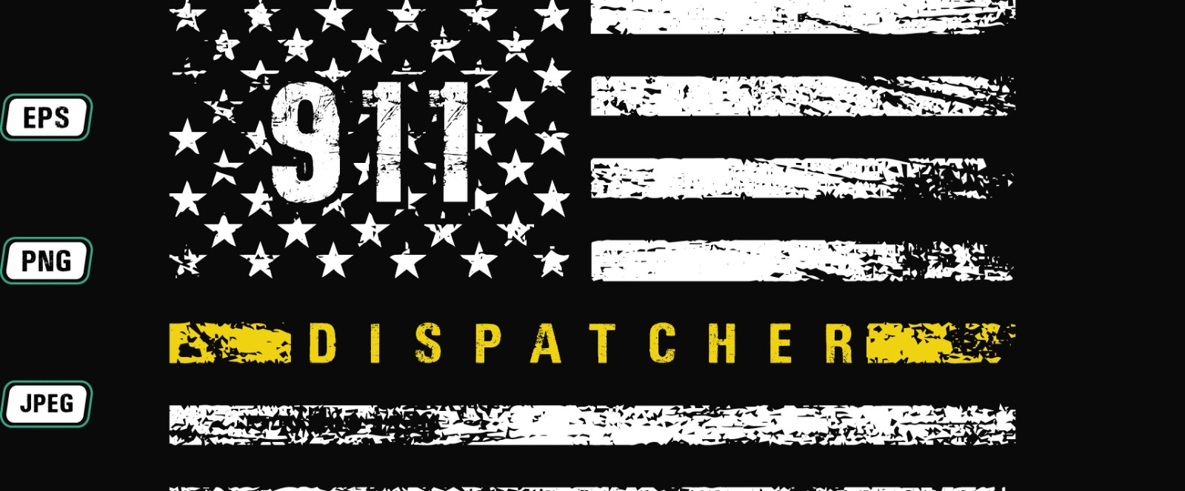
NYPD Call Analysis for Crime Hotspots Prediction and Response Optimization
Team Members:
Heet Gala
Hemanth Chowdary
Mansi Gopani
Kunal Ahhirao

Slide 2

Introduction
The project aims to improve emergency response systems and enhance public safety in New York City by analyzing NYPD call and weather data.
The primary stakeholders in our project are law enforcement agencies, with dispatchers as our secondary stakeholders.
We aim to develop a model that can predict crime incidents in specific areas. This proactive approach can enable law enforcement agencies to allocate resources more effectively, contributing to a safer and more secure environment for residents and visitors alike.

Slide 3
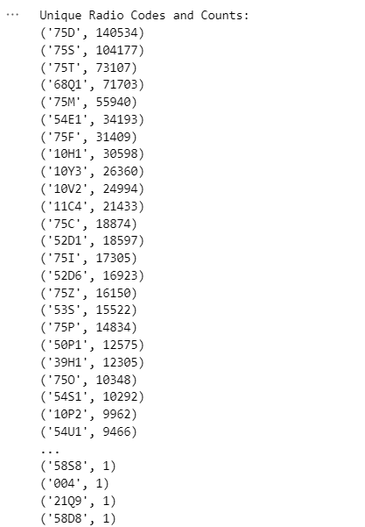

Data Summary
The project relies on a dataset capturing entries in ICAD, the NYPD's 911 system, containing 7,050,127 observations across 18 columns
These columns featuring incident details like borough, type, coordinates, and timestamps for the NYPD emergency responses. It also contains timestamps for dispatch, arrival, and closure of incidents, providing a detailed timeline for each event.
The dataset contains a mix of categorical, numerical, and temporal data types.
One unique aspect is the nearly 100 unique radiocodes present in the dataset, with a focus on the top 8-9 crime radio codes. This focus narrows down the dataset to approximately 450,000 rows, aiding in a more targeted analysis of these specific types of incidents.

Slide 4
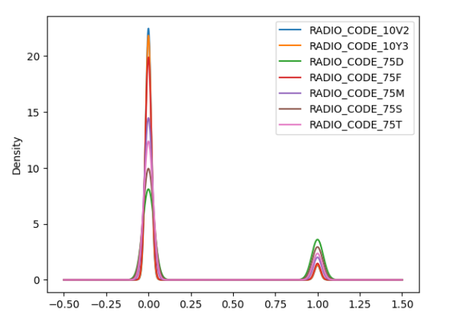
Methodology
Our preprocessing involved converting date and time information into datetime objects for more precise temporal analysis.
NYPD response data were merged with external weather data to examine the influence of weather conditions on response times.
We filtered the data based on radiocodes and implementing one-hot encoding.
For modeling, we used KNN, Decision Tree, and Random Forest algorithms. Among these, the Decision Tree algorithm achieved the highest accuracy.

Slide 5
Analysis
The Decision Tree model achieved the highest accuracy of 70%, we are continuing to refine our models to improve accuracy and gain deeper insights into the factors affecting response times.
Our analysis has shown that response times vary significantly depending on the type of incident and the borough. Incidents classified as "Assault" tend to have response times that are 10% longer than other types of incidents. Additionally, incidents in Manhattan generally have shorter response times, averaging about 5 minutes faster than those in the Bronx.
Weather conditions also have a notable impact on response times. Based on the analysis, the average response time during late evening hours (between 8 PM and 12 AM) was found to be 2.59 minutes, while the average response time during the daytime (between 8 AM and 4 PM) was slightly higher at 2.65 minutes.
The percentage increase in response time from daytime to late evening hours was calculated to be -2.13%. This indicates that, on average, there was a decrease in response time during late evening hours compared to daytime.

Slide 6

Upcoming Work
Future work involves improving the accuracy of our machine learning models for predicting response times.
One limitation we face is the absence of real-time data integration, which could enhance our ability to adjust response strategies dynamically.
In the future, we plan to incorporate more detailed weather data and investigate how specific events and public gatherings affect emergency response times.

Slide 7


